Slide 1
Prior encoding of Superior Colliculus in perceptual decision-making

Slide 2
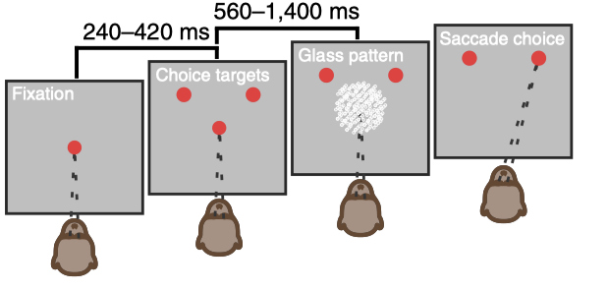
Fig1. Task
Trial Structure
Block design
Equal block
50:50
Unequal block
70:30
Notes:
Top: Trial structure of the Glass Pattern task shown in a temporal sequence. The subject can choose as soon as the glass pattern stimuli appears.
Bottom: Every session is divided in two blocks. First is the equal block with 50/50 probability of left and right choices, The second block has unequal probability, with one target shown 70% probability and the other 30%. Each block consists of 400-900 trials.

Slide 3
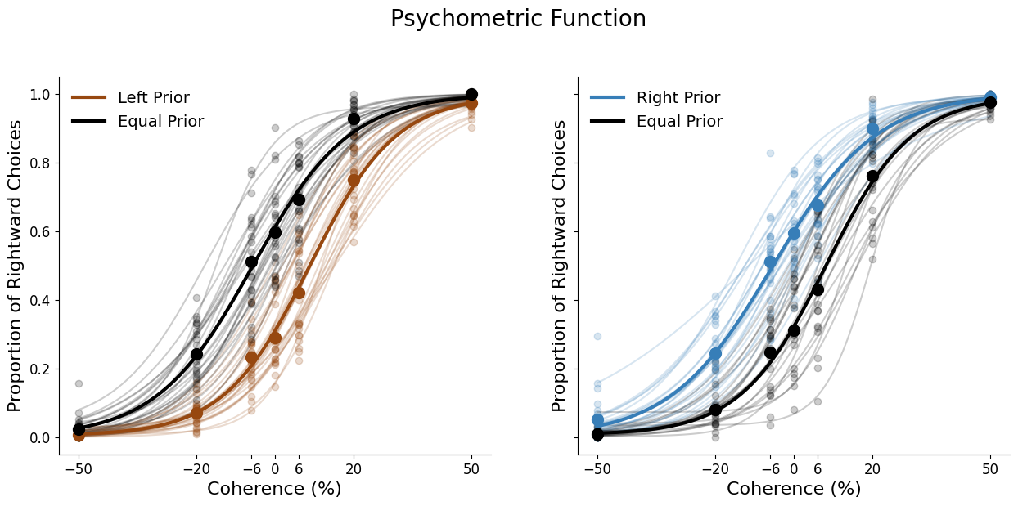
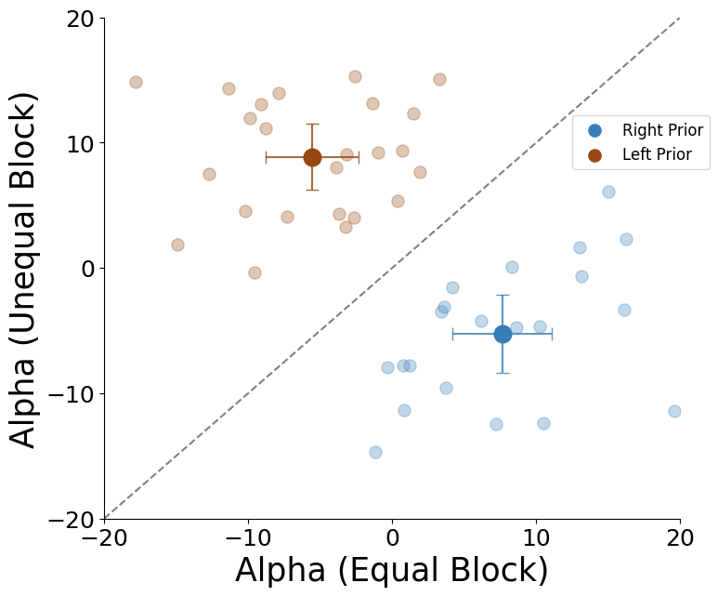
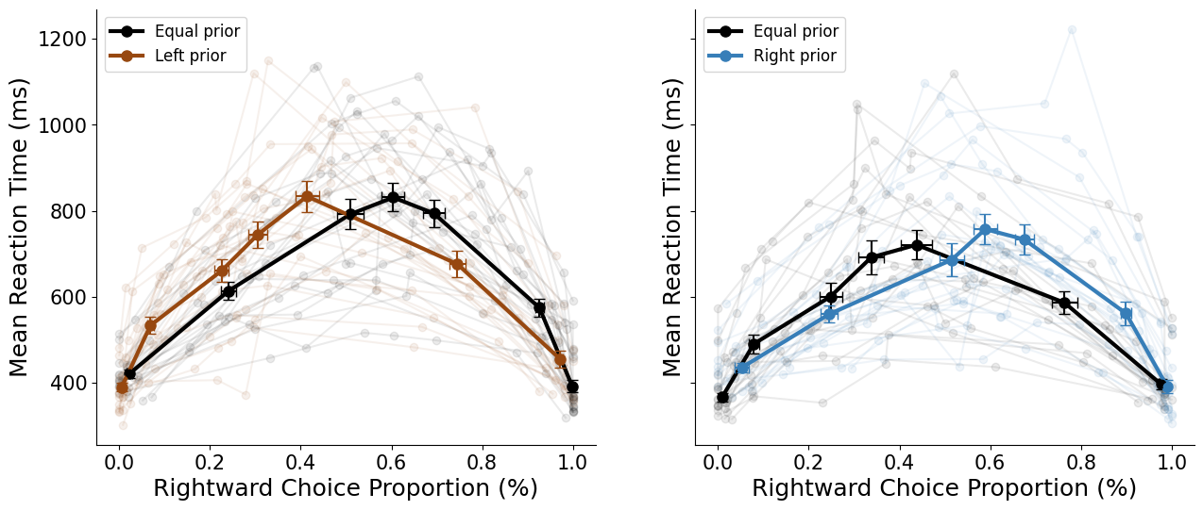
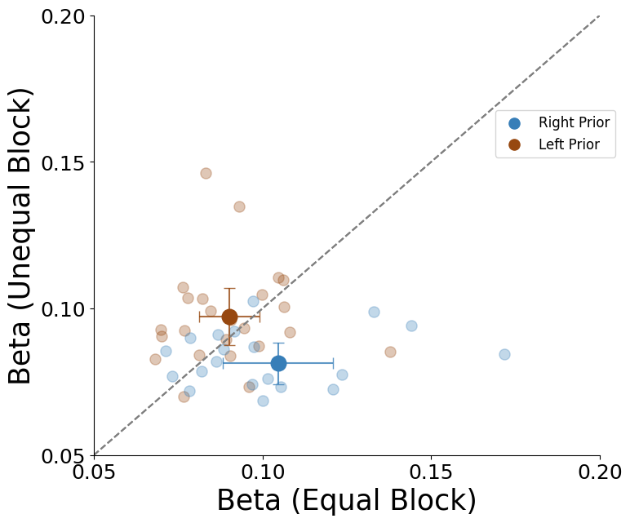
Fig.1 Behavior
Notes:
Psychometric functions of equal and unequal block in left prior(left panel, n=24) and right prior(right panel, n=21) sessions.
Dots are datapoints and lines are logistic fits. Transparent traces are session wise data, thicker traces are mean across sessions.
Top: Scatterplot of logistic fits alpha(threshold) parameters of each session in equal block vs unequal block.
Bottom: Same as top for logistic fit beta parameter.
Blue: left prior sessions, Brown: right prior sessions
241002_GP_TZ equal beta is 0.172

Slide 4
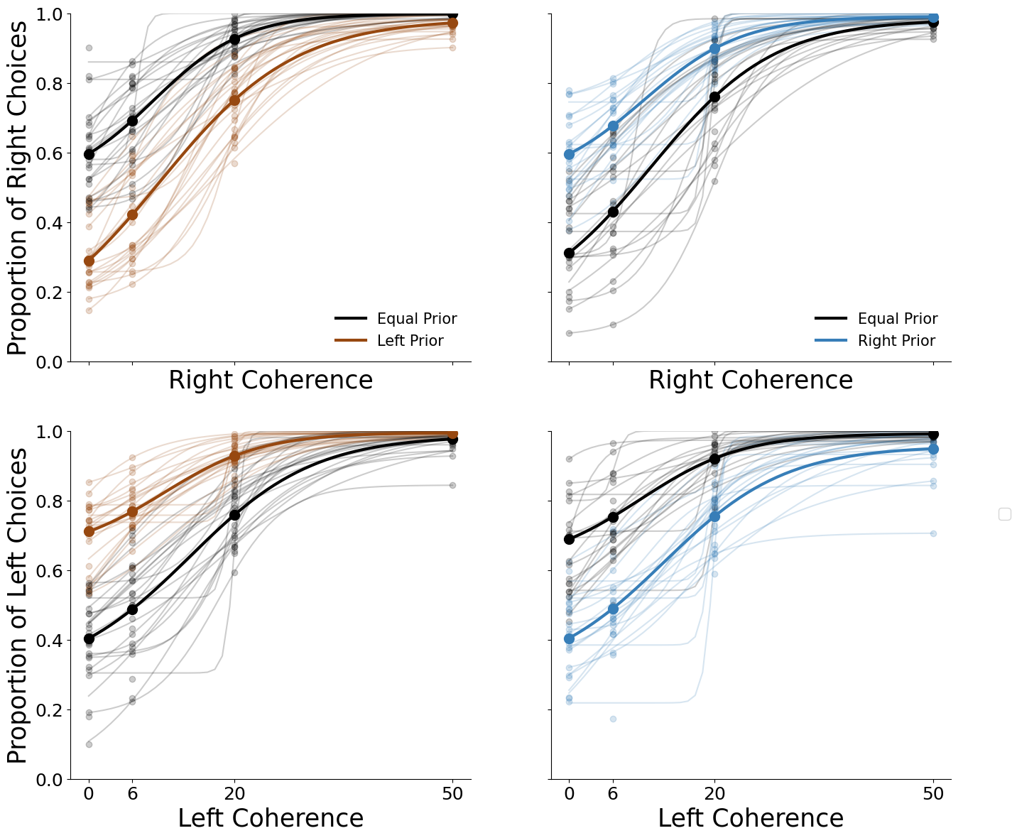
Supp fig 1
Notes:
Half Psychometric functions fit to left and right choices separately

Slide 5
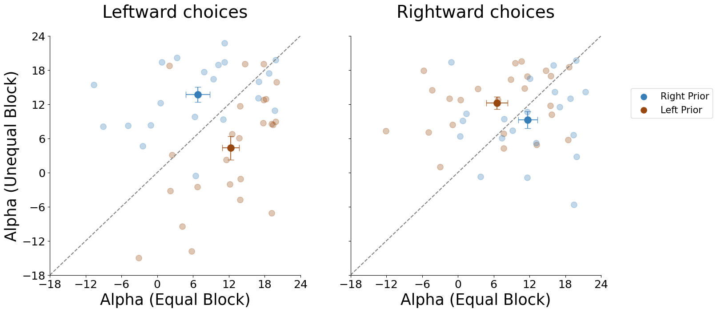
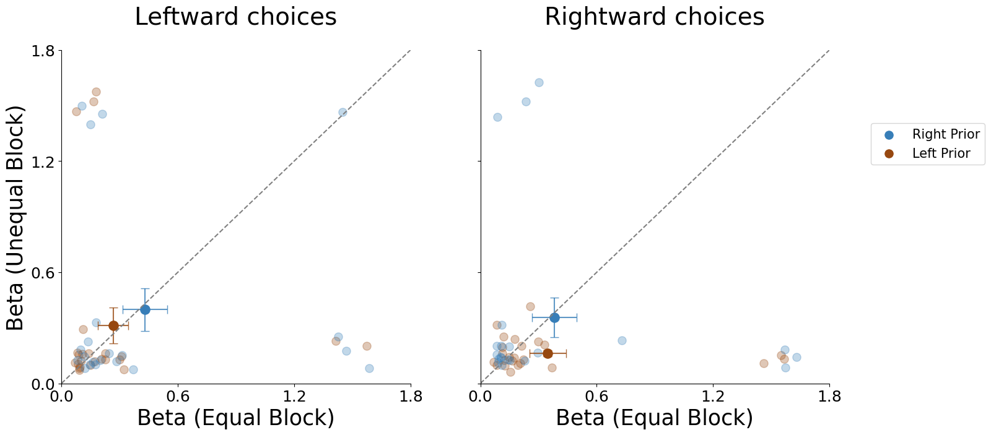
Supp fig 1

Slide 6
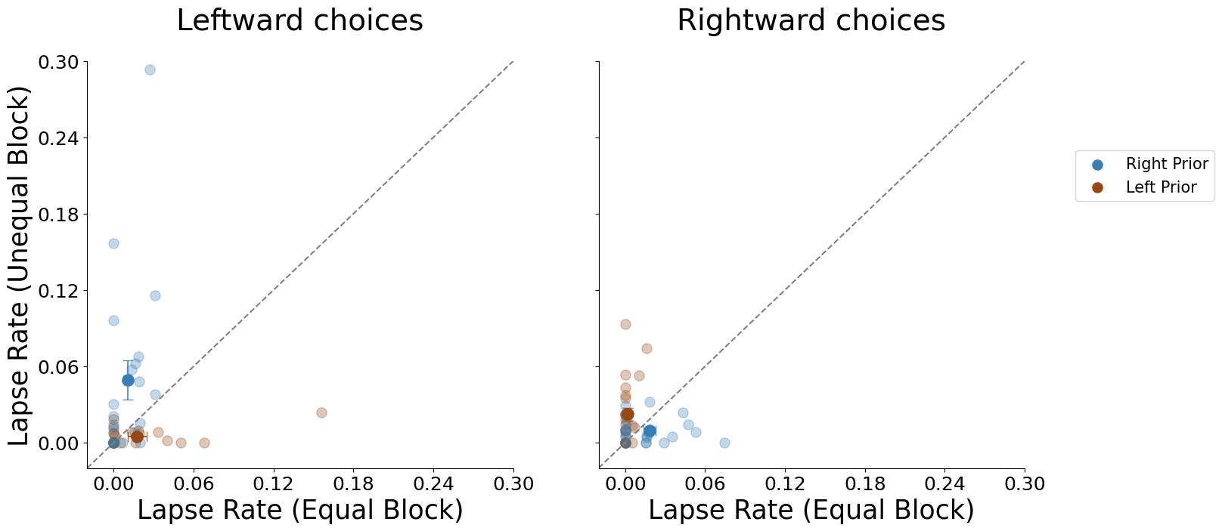
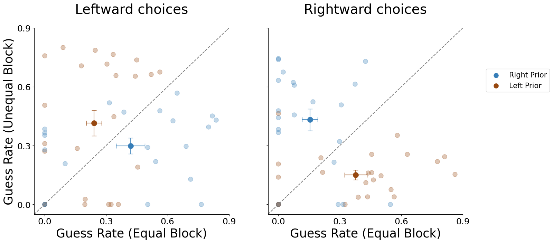
Supp fig 1

Slide 7
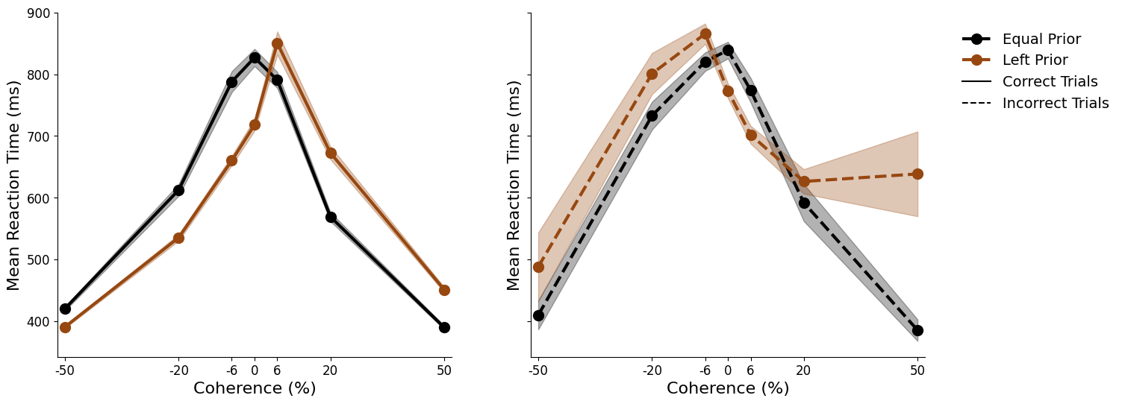
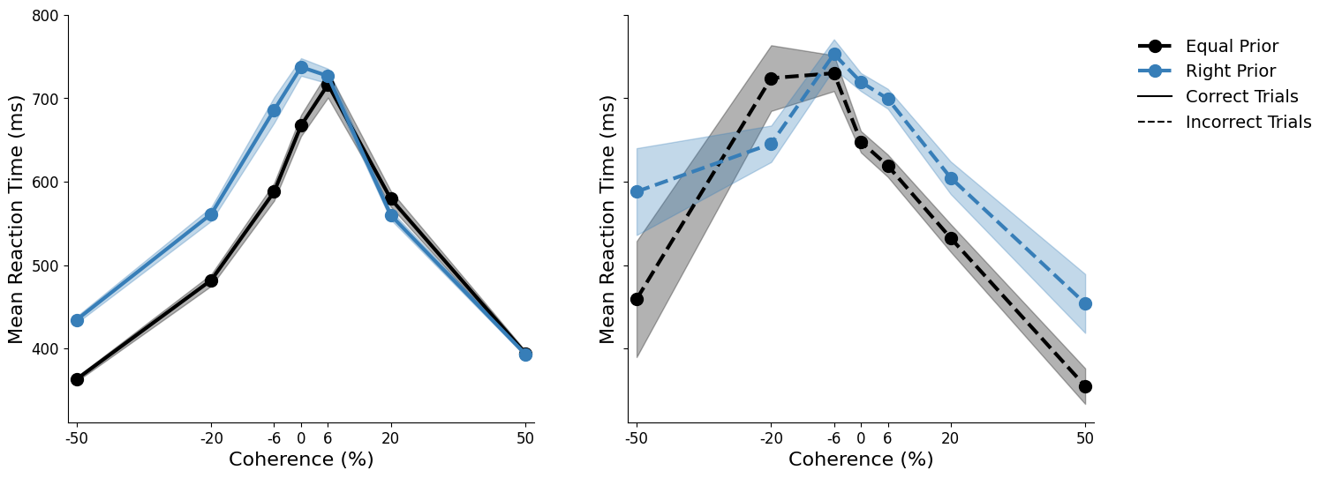
Supp fig.1 Chronometric
Notes:
Chronometric functions of equal and unequal prior blocks for left-prior sessions (top panel, n=24 sessions) and right-prior sessions (bottom panel, n=21 sessions).In each panel, the left subplot shows mean reaction time for correct trials, and the right subplot shows mean reaction time for incorrect trials.

Slide 8
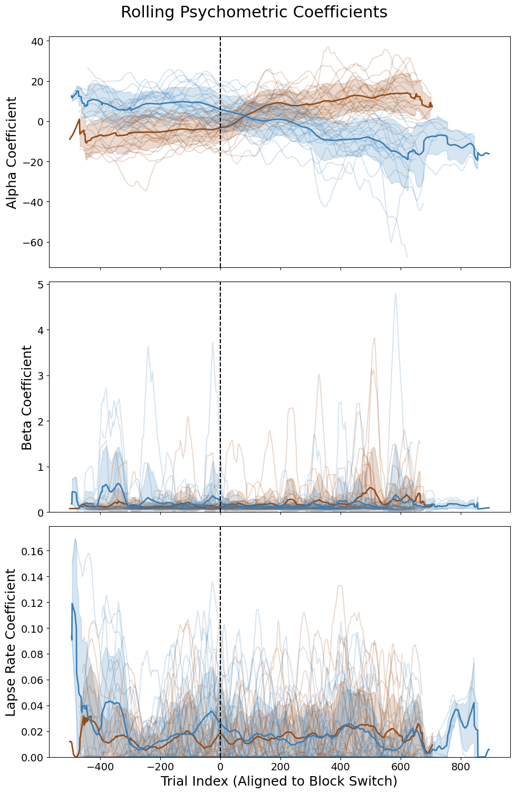
Supp fig.2 Rolling PMF
Psych function every 80 trials.
Convolve with rolling mean kernel of 30 window size

Slide 9
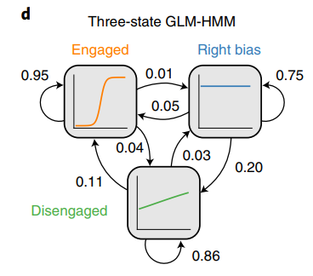
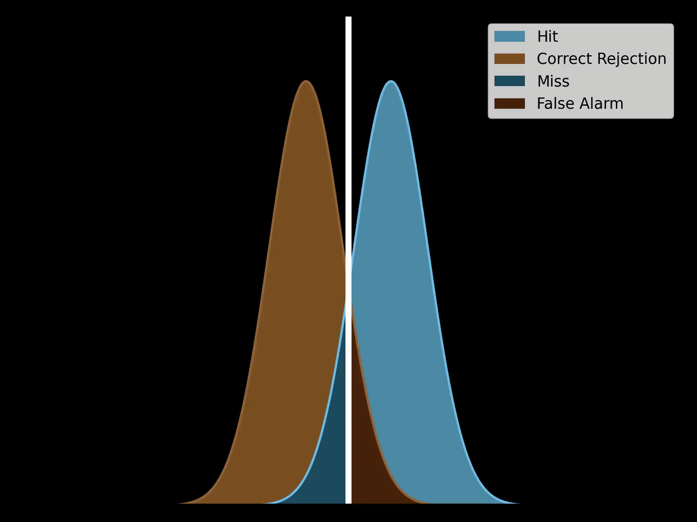
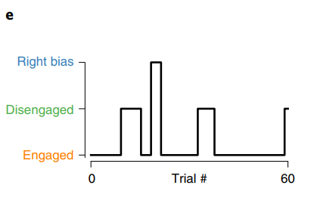

?
Within-trial dynamics which captures RT and accuracy
Fixed bias, no history dependence
Stationary decision criterion
No time or learning
Independent trials
Priors shift bias (α), not sensitivity
Between-trial dependencies
Latent cognitive states
History-aware decision model
Notes:
Traditional psychophysics (SDT) assumes a static criterion and lacks temporal structure. Drift-diffusion models (DDM) introduce within-trial dynamics but ignore across-trial dependencies. GLM-HMM bridges the gap by modeling hidden cognitive states that evolve over trials and shape decisions.

Slide 10
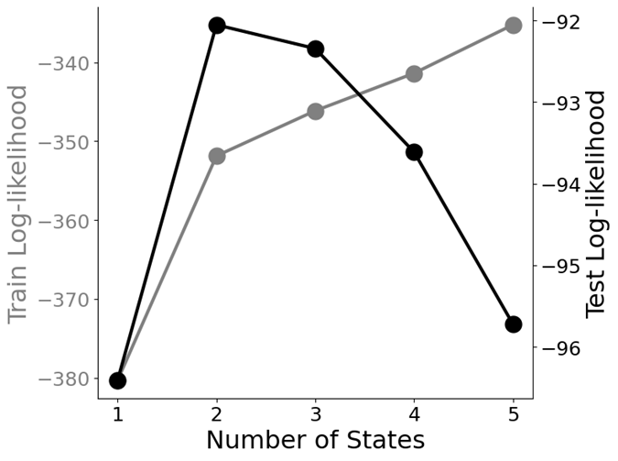
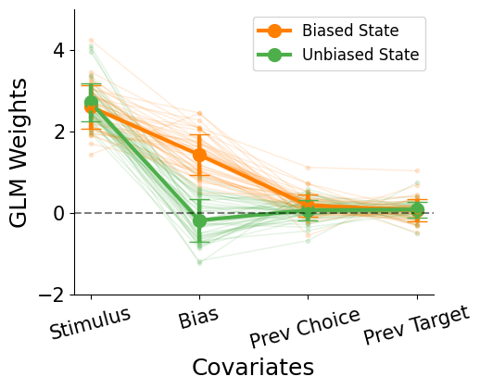
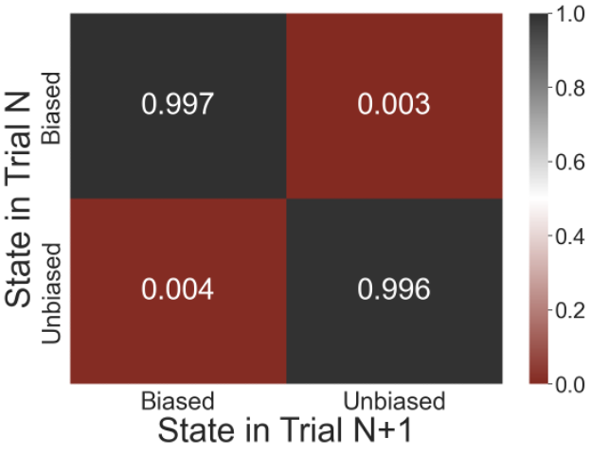
Fig. 2 GLM-HMM
Notes:
Biased to Biased: [0.990, 1.000]
Biased to Unbiased: [0.000, 0.010]
Unbiased to Biased: [0.000, 0.009]
Unbiased to Unbiased: [0.991, 1.000]
The ranges above are clipped between 0 and 1

Slide 11
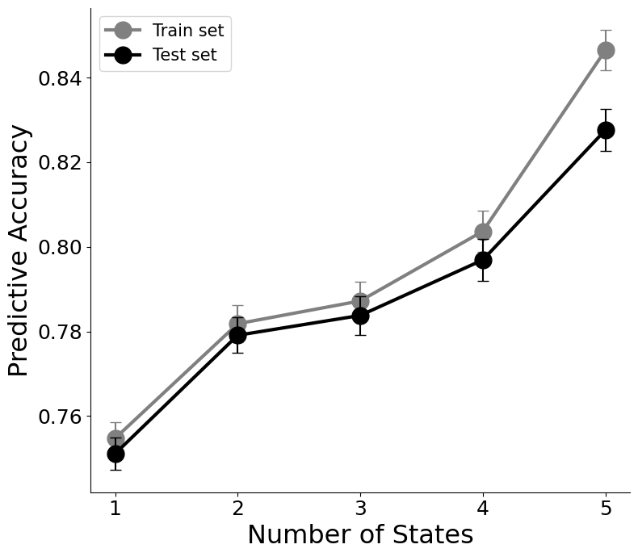

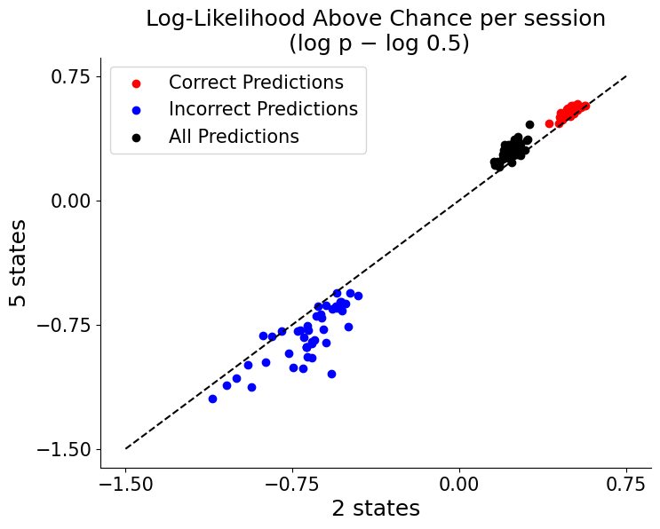
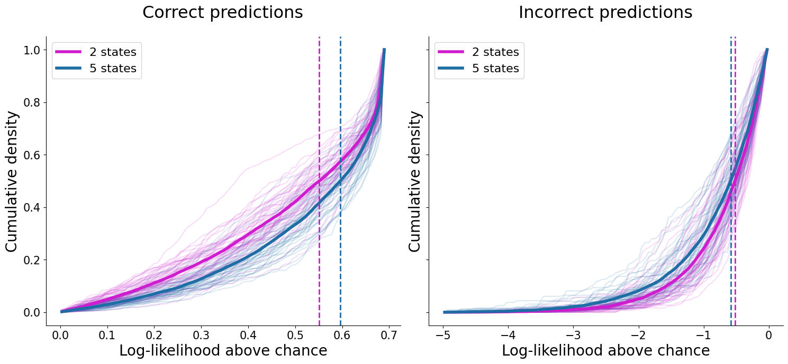
Supp Fig. 2 GLM-HMM whole session
Notes:
Log-likelihood: 2 states is the best
Predictive accuracy: 5 states is the highest
5 states models are overall over-confident, i.e. higher penalty on incorrect predictions

Slide 12
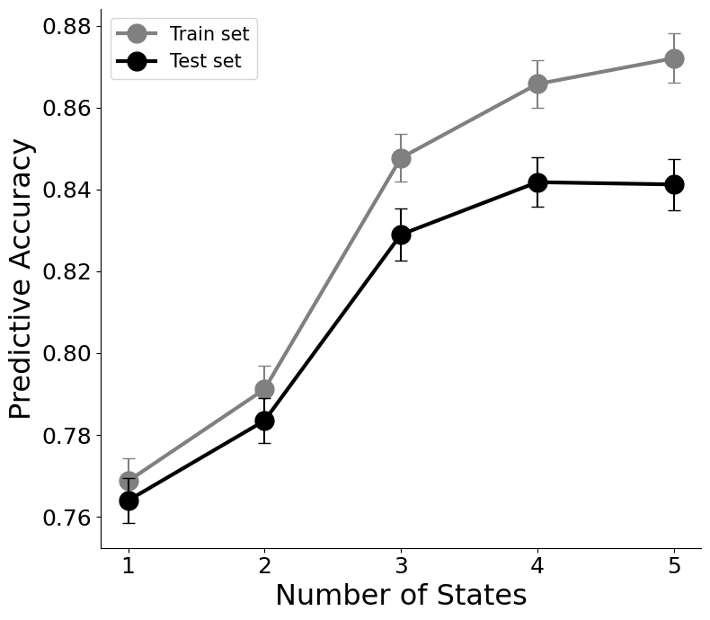
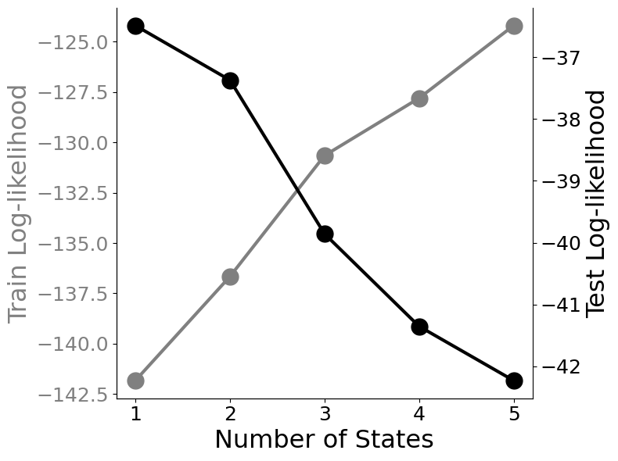
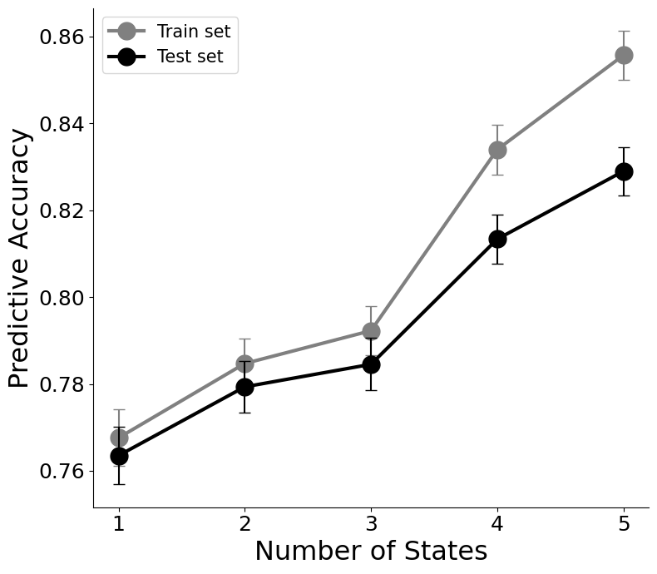
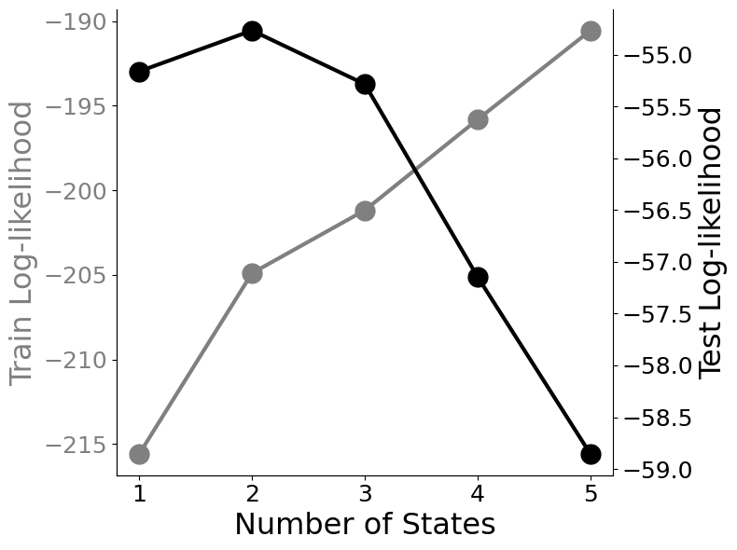
Supp Fig. 2
GLM-HMM equal prior only
GLM-HMM unequal prior only
Notes:
Equal prior only: 1 state
Unequal prior only: 2 states

Slide 13
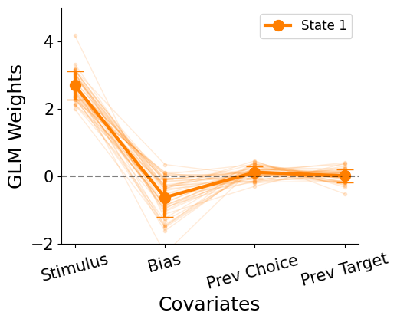
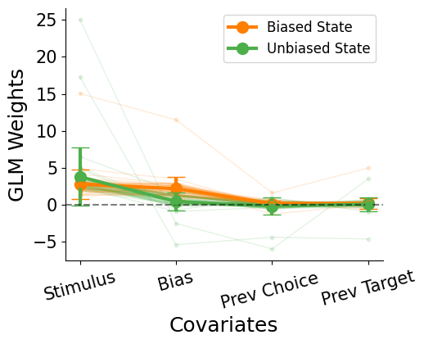
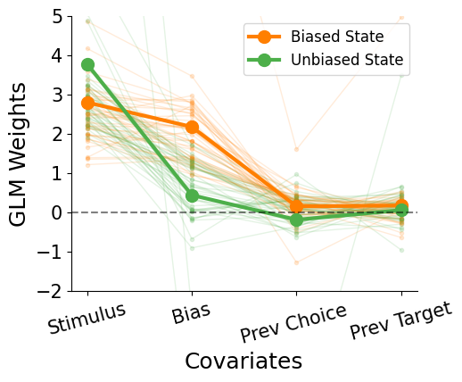
Supp Fig. 2
GLM-HMM equal prior only
GLM-HMM unequal prior only
Notes:
Equal prior only: 1 state
Unequal prior only: 2 states

Slide 14
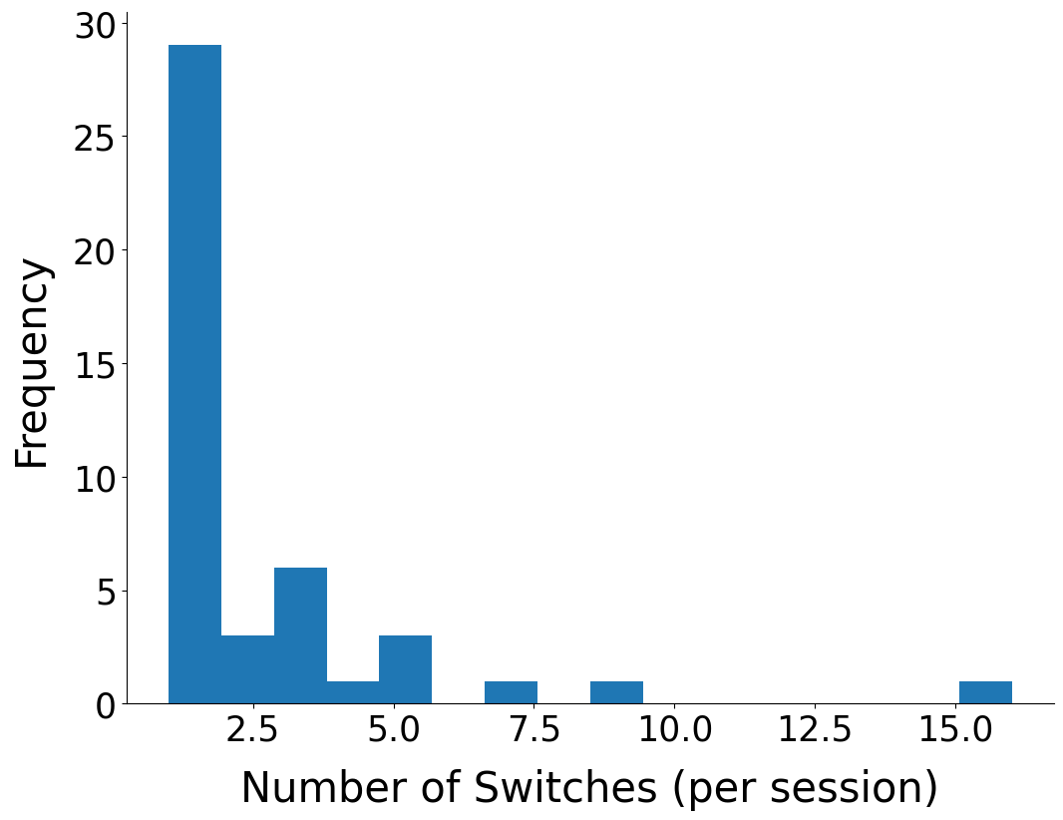
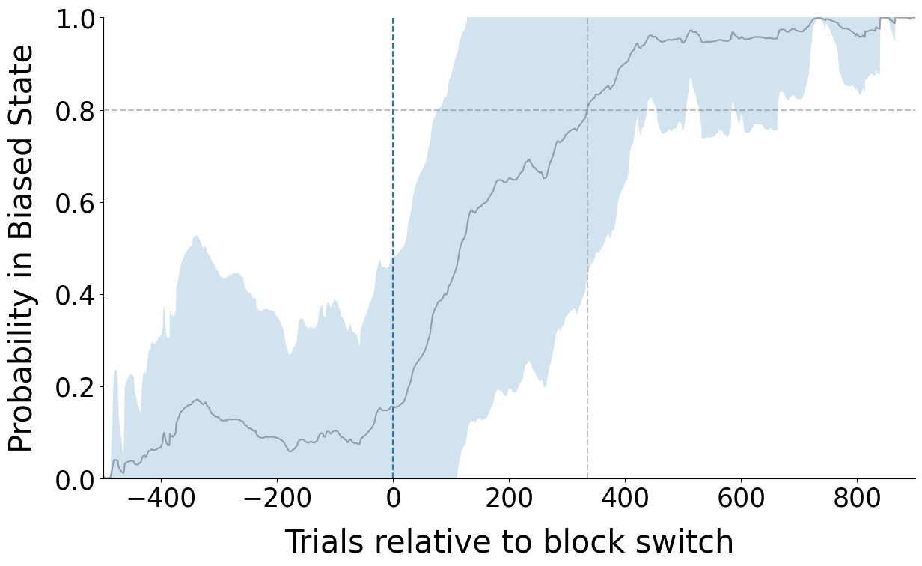
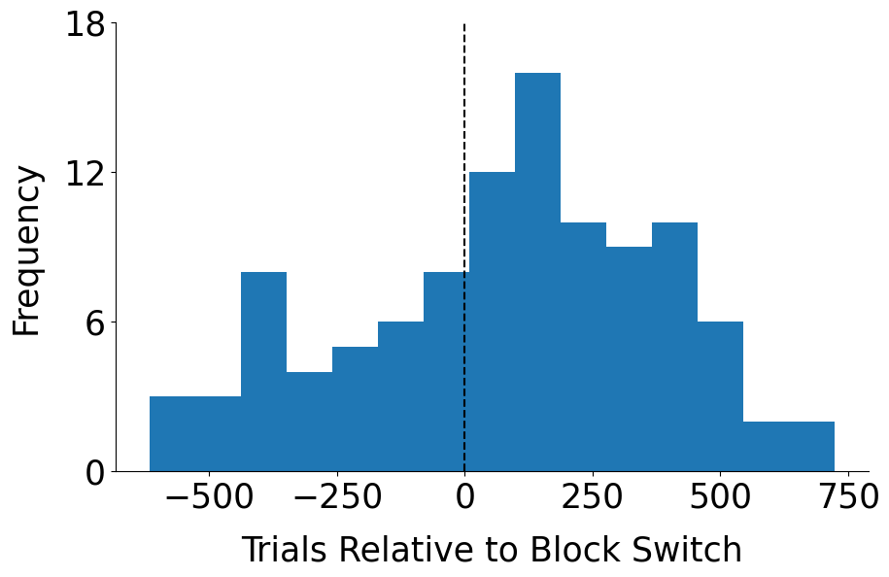
Fig. 2 GLM-HMM

